Slide 1
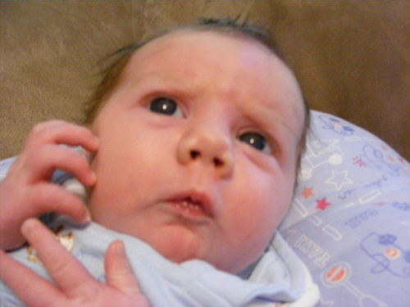
Which Infants should I worry about? Education for all staff caring for newborn infants
Created by
Róisín McKeon-Carter
Nurse Consultant
Neonatal Safety Champion
Edited and Narrated by
Diane Keeling
Advanced Neonatal Nurse Practitioner

Slide 2
Objectives
Increase knowledge & understanding of the importance of evaluating the newborn infant
Recognise worrying signs and symptoms of the potentially unwell infant
Understand the escalation and referral process for infants for whom you are worried about

Slide 3
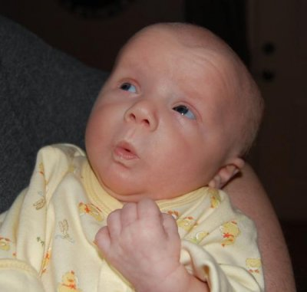
Should I be worried?
History
Examination
Getting help

Slide 4
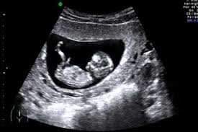
The Worrying History Read, Listen and Look!
Notes
Antenatal Scans
Safeguarding
‘Neonatal Alert’ System
Maternal & Baby Information Record
ALERT
LOOK
INSIDE

Slide 5
MATERNAL & BABY INFORMATION RECORD

Slide 6
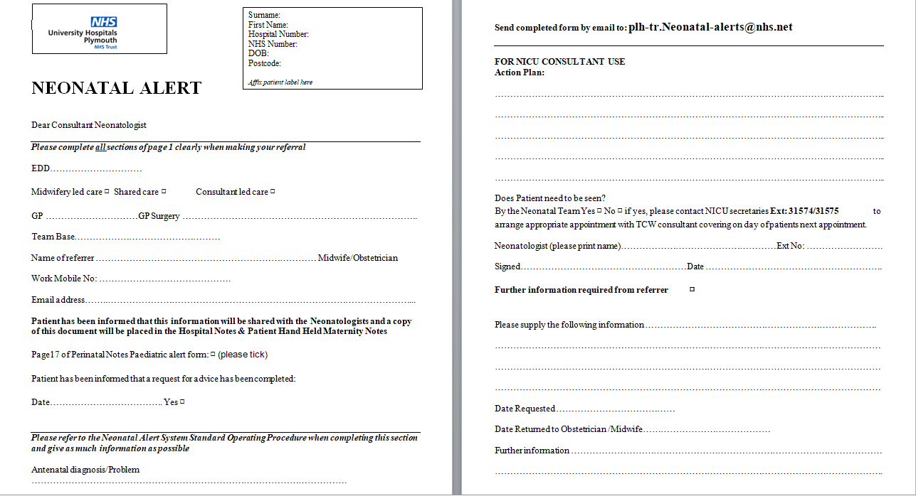

Slide 7
The Worrying History
Read, Listen and Look!
Worried parents - always listen to parental concerns
Worried health care professional - specific and non specific concerns,
and irrespective of review

Slide 8
The Worrying History
Read, Listen and Look!
The history does not ‘match’ the clinical presentation
This infant is not quite right
Examine the infant

Slide 9
Worrying numbers A Game of Two Halves!
Too Small (IUGR) Too Big (Macrosomic)
Too Little (Weight Loss >12.5%) Too Much
Too Cold (<36.5) Too Hot (>37.5)
Too Slow (Hr, RR) Too Fast (Increased WOB)
Too Quiet (lethargic) Too Active(Jittery/Irritable/Abnormal)
Too Pale (Hb/Anaemia/Infection) Too Red (Plethoric/Jaundice)
Too bitter (Low BGL) Too Sweet (Raised BGL)

Slide 10
More worrying numbers
Cord blood gas - Ph ≤7.0
Cord bilirubin - At treatment level for gestational age when plotted appropriately
Blood Group - ABO/ Rhesus incompatibility
DAT - Weakly or strongly positive
BGL - <2.0mmol/l in the asymptomatic term baby ≤37/40
- <2.6mmol/l in the preterm ≥36+6/40
Neonatal Blood Gas
Oxygen saturations <95%(pre and post ductal)
Any other blood results?

Slide 11
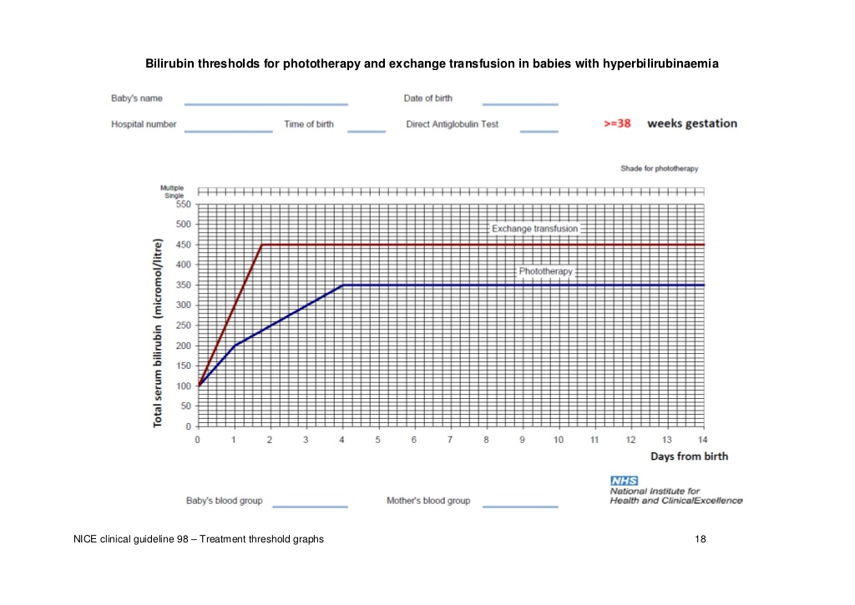

Slide 12
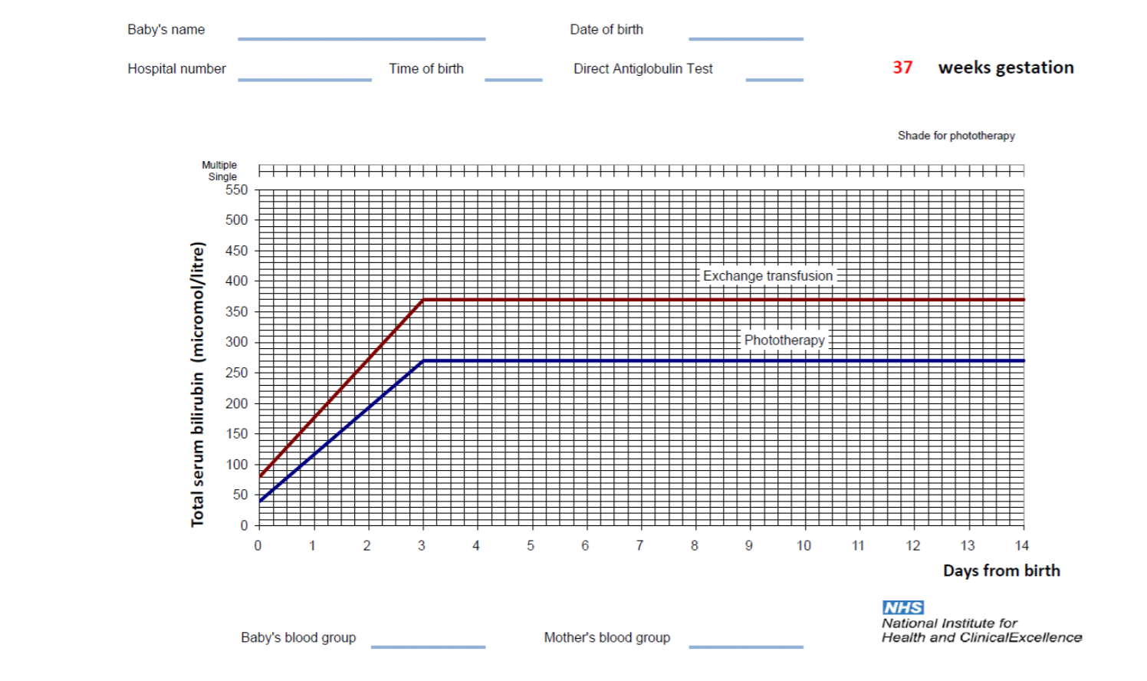

Slide 13
Worrying Colours
Red
Plethoric Rashes
Sepsis
Yellow
Jaundice < 24 hours of age
Take SBR
Start phototherapy
Immediately refer to Neonatal Team
Green
Bilious Vomit
Meconium at delivery
White/Pale – Sepsis
Anaemia
Purple
Bruising
Bleeding
Blue/Cyanosis Cardiac or Respiratory

Slide 15
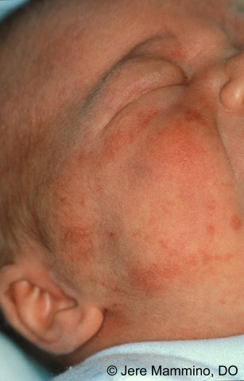
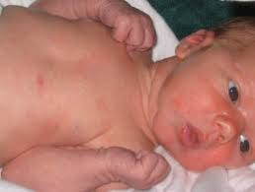
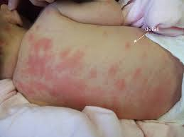
NORMAL NEWBORN RASH
Erythema neonatorum is a maculo-papular rash which occurs in normal term babies and fades within the first week of life.
It looks dramatic but it is benign/normal. Although no treatment is required, parents may need a lot of reassurance

Slide 16
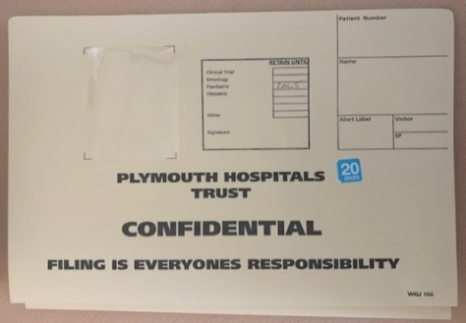
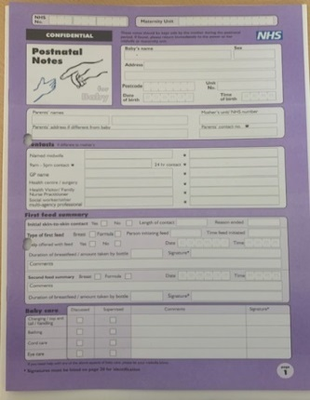
The worrying examination
Record your observations clearly and accurately –
Midwifery and MCAs write in the purple post natal notes
Neonatal team write in the Infant’s buff notes
ENSURE YOU CROSS CHECK BOTH SETS OF NOTES

Slide 17
NEWTT

Slide 18
Getting Help
“ I am Worried” – What now?
S - Explain why you are concerned
B - Give as much information as possible
A - Explain why you are requesting a review
R - Indicate the urgency of the review
URGENT? SOON? ROUTINE?

Slide 19
Getting Help URGENT!
Apnoea/s
Cyanosis
Seizures

Slide 20
Getting Help SOON!
Grunting
Bilious vomit or abdominal distension
Hypoglycaemia
Irritable or drowsy
Other abnormal “NEWTT” observations

Slide 21
Getting Help ROUTINE
Structural abnormalities
Hypospadias
Skin tags
Extra digits
Talipes
Tongue tie
Any other concerns which are not directly impacting on the infants current health status

Slide 22
Documentation #NIPE

Slide 23
Important
Communicate effectively with the parents throughout
Ensure you are available to discuss any concerns and answer questions
Initiate investigations where appropriate e.g.
Jittery baby – check the blood sugar
Grunting baby – take blood gas or check oxygen saturations
If your concerns are not being actioned, recontact the neonatal team and increase the urgency of your review. If this does not result in a review, contact a more senior colleague.

Slide 24
Summary
Read, Listen, and Look
Good communication is essential with both the family and the neonatal team
Ensure your concerns are actioned

Slide 25
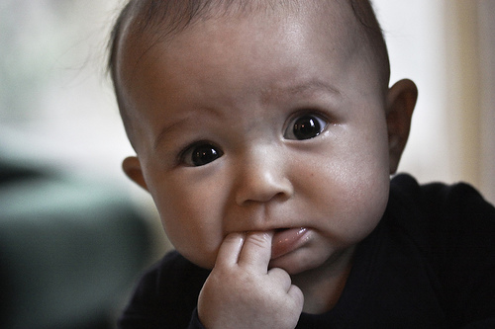
“Levy’s law of neonatology”
Never trust a neonate

