Slide 1
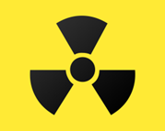
iCM e-learning
Radiation Protection for Referrers

Slide 2
Purpose
This training is to ensure that anyone requesting a medical exposure involving ionising radiations understands:
The potential risks involved
Is aware of the referral guidelines which should be followed
The information which must be provided
The importance of avoiding errors
Their statutory responsibilities
Issues concerning MRI safety are also considered

Slide 3
For Queries & More Information
Imaging
Principal Radiographer – Diana Nicholson diana.nicholson@nhs.net
Imaging Service Line Clinical Director - Abdul Gafoor plh-tr.SLCD-Imaging@nhs.net
MRI – Christine Heales - christine.heales@nhs.net
Radiology IT - imagingit@nhs.net
Radiation Protection
Head of Clinical and Radiation Physics - Nick Rowles nrowles@nhs.net Tel. 39669
Consultant Physicist in Nuclear Medicine– Ivor Jones ivor.jones@nhs.net Tel. 52281
Clinical Specialist in Radiation Protection – Julie Stevens j.stevens4@nhs.net Tel. 31997
For iCM training or support, contact the IT Service Desk:
Online: http://online.plymouthict.nhs.uk - phone: (4) 37000 – e-mail: plymouthictservicedesk@nhs.net

Slide 4
Imaging Modalities using Ionising Radiation (IR)

Slide 5
Alternative Imaging Modalities

Slide 6
MRI Safety
MRI does not use ionising radiation and safety is covered by MHRA guidelines (not IR(ME)R)
There are risks associated with the magnetic field and RF pulses, in particular with implanted devices:
Displacement (if ferrous components)
Malfunction (active implants e.g. pacemaker, ICD, infusion pump, nerve stimulators etc.)
Heating and possibility of burns (any implant with a metallic component)
The only implants that are MR SAFE do NOT contain any conductive, metallic or magnetic components

Slide 7
MRI Safety
Implants with conductive, metallic or magnetic components are either MR CONDITIONAL or MR UNSAFE
Increasingly implants are manufactured with MRI safety in mind and are MR CONDITIONAL
This means they can be scanned under stringent, predefined conditions (i.e. field strength, spatial gradient, specific absorption rate (SAR), device settings)
The MRI team NEED TO KNOW the make and model of any implant in order to determine whether they can meet these conditions

Slide 8
MRI Safety
If you, the referrer, please highlight the presence of an implant (and give make and model where possible), the patient’s journey through MRI is more efficient.
The MRI department will make the final decision about whether or not it is safe to scan a patient with a particular implant in situ.

Slide 9
MRI Safety
MRI and Nephrogenic Systemic Fibrosis
There is an association between patients with poor renal function and NSF
If your patients needs MRI contrast, we will require a eGFR within 3 months of their appointment if they:
Are aged under 1, or 65 or over
Are receiving renal dialysis or have renal impairment
Have diabetes
Are peri-liver transplant
Having a liver MRI
If in doubt, please provide a recent eGFR.

Slide 10
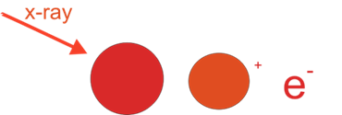
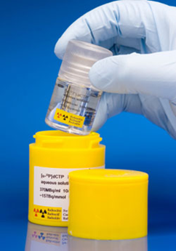
Properties of Ionising Radiation
Ionising radiation is part of the electromagnetic spectrum and has properties similar to visible light and microwaves etc.
Ionising radiation has high energy and the ability to remove an electron creating ions which can cause biological damage and harm.
Types include X-rays, γ (gamma) rays as well as α, β particles.
Notes:
simplify

Slide 11
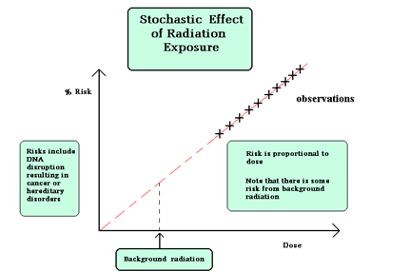
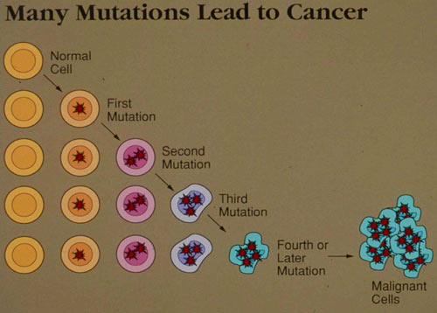
Biological Effects and Reactions from Radiation
Stochastic effects
Have a linear no threshold relationship with radiation exposure
i.e. there is no safe level of exposure.
The main concern is the risk of cancer.
Cancer induction latency
> 2 years for leukaemia
> 10 years for solid tumours
Notes:
May need 2 slides !

Slide 12
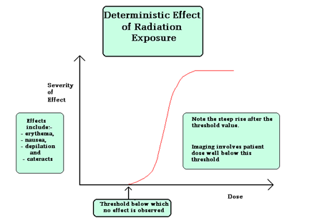
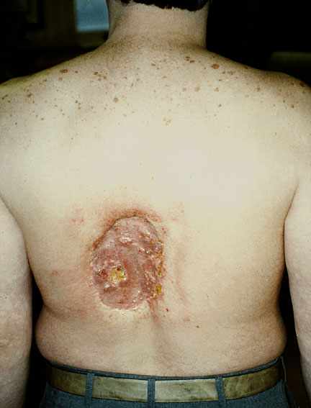
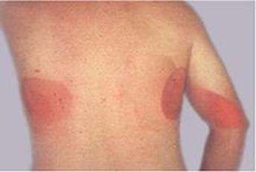
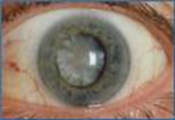
Biological Effects and Reactions from Radiation
Deterministic or tissue reactions
There is a dose threshold
There is no effect below the threshold
The severity increases with exposure
Effects include
Skin damage
Cataracts
Cardiovascular effects
Notes:
May need 2 slides !

Slide 13
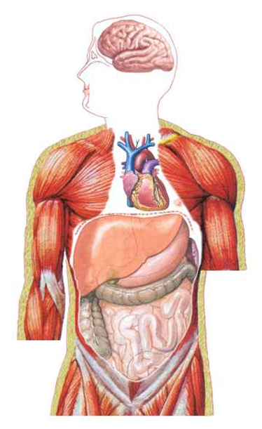
How do we measure radiation dose and risk.
Effective dose is measured in milli-sieverts (mSv) and is used to quantify risk.
Effective dose depends on
The amount of energy absorbed in tissue (absorbed dose)
The type of radiation whether x or γ rays or α or β particles (equivalent dose)
The organs irradiated, and their sensitivity to radiation
Effective dose relates directly to risk of fatal cancer induction regardless of type of examination

Slide 14
Typical Doses from Common X-ray Examinations
Limbs
0.004
Chest
0.01
Skull
0.03
Pelvis
0.33
Lumbar Spine
0.58
Barium Meal
1.33
CT Abdomen
5.0
0.00
0.50
1.00
1.50
2.00
2.50
3.00
3.50
4.00
4.50
5.00
Dose [years of background radiation]
Figures taken from: RCR Working Party. Making the best use of a Department of Clinical Radiology: Guidelines for Doctors (Fourth Edition). London: The Royal College of Radiologists, 1998.

Slide 15
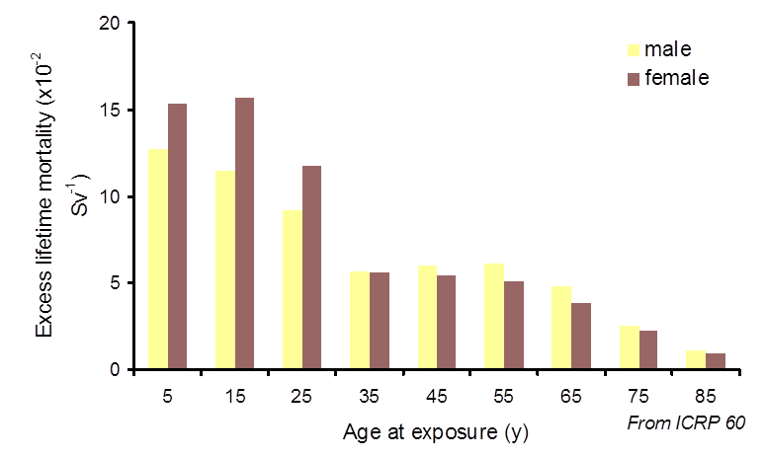
Risk from exposure
Risk from Exposure
Risk from exposure varies with both sex and age making it particularly important to consider this regarding exposures for paediatrics.

Slide 16
Radiation Dose and Risk from Diagnostic Examinations
Typical effective doses from diagnostic medical exposure
Radiographic Examination | Typical effective dose (mSv) | Equiv. no chest x-rays | Approx. equiv. Background radiation
Limbs & Joints (except hip) | < 0.01 | <1 | < 2 days
Chest (PA) | 0.015 | 1 | 2.5 days
Thoracic Spine | 0.4 | 30 | 2 months
Lumbar Spine | 0.6 | 40 | 3 months
Abdomen | 0.4 | 30 | 2 months
IVU | 2.1 | 140 | 11.5 months
Barium Swallow | 1.5 | 100 | 8 months
Mammography (2 view) | 0.5 | 35 | 3 months
CT Head | 1.4 | 90 | 7.5 months
CT Chest | 6.6 | 440 | 3 years
CT KUB | 5.5 | 370 | 2.5 years
CT colonography | 10 | 670 | 4.5 years
CT chest abdomen pelvis | 10 | 670 | 4.5 years
Radionuclide Procedure | Typical effective dose (mSv) | Equiv. no chest x-rays | Approx. equiv. Background radiation
Lung ventilation (Tc-99m) | 0.4 | 30 | 2 months
Thyroid (Tc-99m) | 1 | 70 | 6 months
Kidney (Tc-99m) | 0.7 | 50 | 4 months
Bone (Tc-99m) | 3 | 200 | 1.4 years
Dynamic Cardiac (Tc-99m) | 6 | 400 | 2.7 years
PET CT (body) | 18 | 1200 | 8.1 years
From
/ Public Health England
Notes:
Same as slide 11 ?

Slide 17
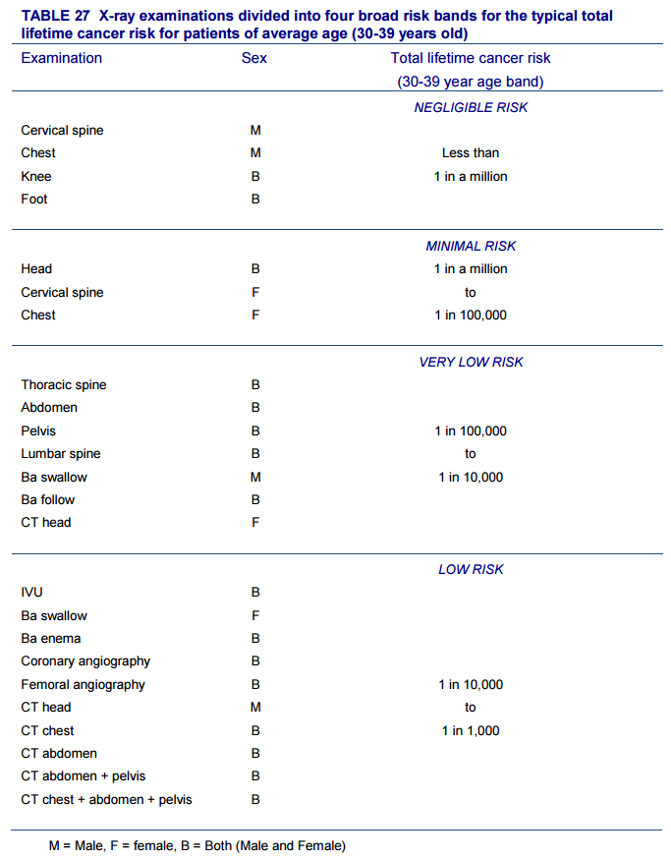
Categorising Risk from Diagnostic Radiation Examinations
Risk from chest and limb plain x-rays is minimal compared to the more significant risk associated with CT and CT PET imaging (a nuclear medicine examination)
It is important to consider the most appropriate examination to answer the clinical question
HPA-CRCE-028
Radiation Risks from Medical X-Ray Examinations as a Function of the Age and Sex of the Patient :
Health Protection Agency 2011
Notes:
Keep this

Slide 18
Framework
How do we protect patients needing diagnostic x-ray (ionising radiation) examinations?
Ionising Radiation (Medical Exposure) Regulations
(IR(ME)R)

Slide 19
Notifications
The Trust must notify CQC of certain errors
Exposures involving the wrong patient
Exposures which are “much greater than intended”
Unintended exposures of the foetus
If a referrer makes repeated errors they may have their entitlement revoked.

Slide 20
Reason for this training
CQC IR(ME)R Reports August 2014 / 2015
Referral errors in light of electronic requesting
Although notification rates for misidentification of patients are low, they do still remain an issue within radiology – especially in light of the adoption nationally of electronic requesting packages. Feedback from Trusts has highlighted that a lack of relevant training for referrers has been the main cause for the selection of incorrect patients.

Slide 21
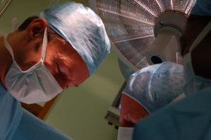
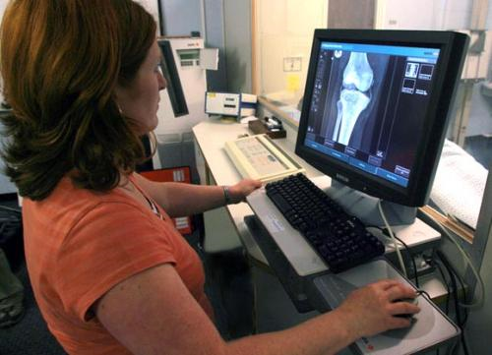
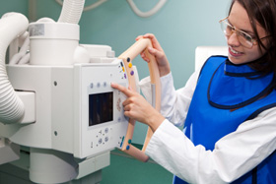
Four IR(ME)R Duty Holders
Employer : any natural or legal person who, carries out, or engages others to carry out, medical exposures or practical aspects, at a given radiological installation.
Referrer : means a registered medical practitioner, dental practitioner or other health professional who is entitled in accordance with the employer’s procedures to refer individuals for medical exposure to a practitioner.
Practitioner : means a registered medical practitioner, dental practitioner or other health professional who is entitled in accordance with the employer’s procedures to take responsibility for an individual medical exposure.
Operator : means any person who is entitled, in accordance with the employer’s procedures, to carry out practical aspects of any exposure.
Notes:
Animate so each come in separately ?
IRMER mentioned without saying what it is

Slide 22
Employer’s Responsibility Includes
Written protocols and procedures
Entitlement regarding who can act as Referrer
Patient ID Policy
Referral criteria
A referral framework
Justification of exposures
Examination protocols

Slide 23
Employer’s Responsibility : Entitlement - Framework
The Employer entitles medical and dental practitioners and ‘other’ registered healthcare professionals to request medical exposures.
For ‘other healthcare professionals’ entitlement specifies the ‘Scope of Practice’ i.e. what can be referred by that individual.
Imaging hold a ‘list’ of entitled non-medical referrers and their referral scope.
If you are unable to request imaging on iCM then contact Di Nicholson Principal Radiographer at diana.nicholson@nhs.net

Slide 24
Employer’s Responsibility : Referral Criteria
The Royal College of Radiologists have provided a framework which is accessible via the question mark here.
This aids referrers in the most appropriate type of imaging and the radiation risk involved.
http://nww.irefer.nhs.uk/

Slide 25
Responsibilities of the Referrer
The Referrer (the person completing the request) has a duty to:
Ensure the request is appropriate by checking for previous imaging and requests, and is made in accordance with the referral criteria.
Correctly identify the patient.
Provide details concerning pregnancy for women of child bearing age where appropriate.
Provide relevant clinical details to allow the Practitioner to consider the merits of the request.
Clearly identifies themselves and provides contact details.

Slide 26
Responsibilities of the Referrer Preventing ID Errors
Confirmation of correct patient selection
iCM operates a system check asking you to confirm this is the correct patient.
As the Referrer this is your legal responsibility to check under IRMER.
CQC IR(ME)R Report 2012
5. Referring the wrong patient. A large proportion of the notifications made to us from radiology departments involve 'the wrong patient', and a high proportion of those are a result of referrer errors. We have seen a number of initiatives to tackle errors initiated by referrers….Another has introduced a system where each 'culprit' referrer receives a strongly worded letter from the Chair of the Radiation Protection Committee to remind them to take due care in selecting the correct patient or examination next time, with a copy of the letter placed on their personal file and shared with their consultant.

Slide 27
Responsibilities of the Referrer Preventing Duplicate Requests
Notes:
Do we need “it is your responsibility to check to ensure that the request is appropriate and that a previous relevant exam has not been performed
Text is confusing as “may be” and “employer must clarify” training must specify

Slide 28
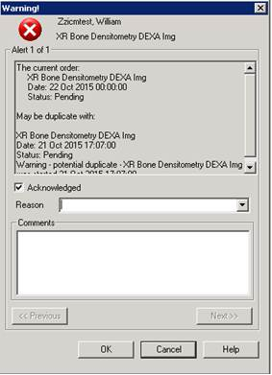
Responsibilities of the Referrer Preventing Duplicate Requests
If there has been a duplicate request on iCM a flag will show this and you can decide whether your request is still necessary.
NB. If there is a duplicate request by paper or ICE (GP and Oncology electronic requesting system) or EDIS (emergency department electronic requesting system) iCM will NOT currently flag this up. So your request can still be duplicated.

Slide 29
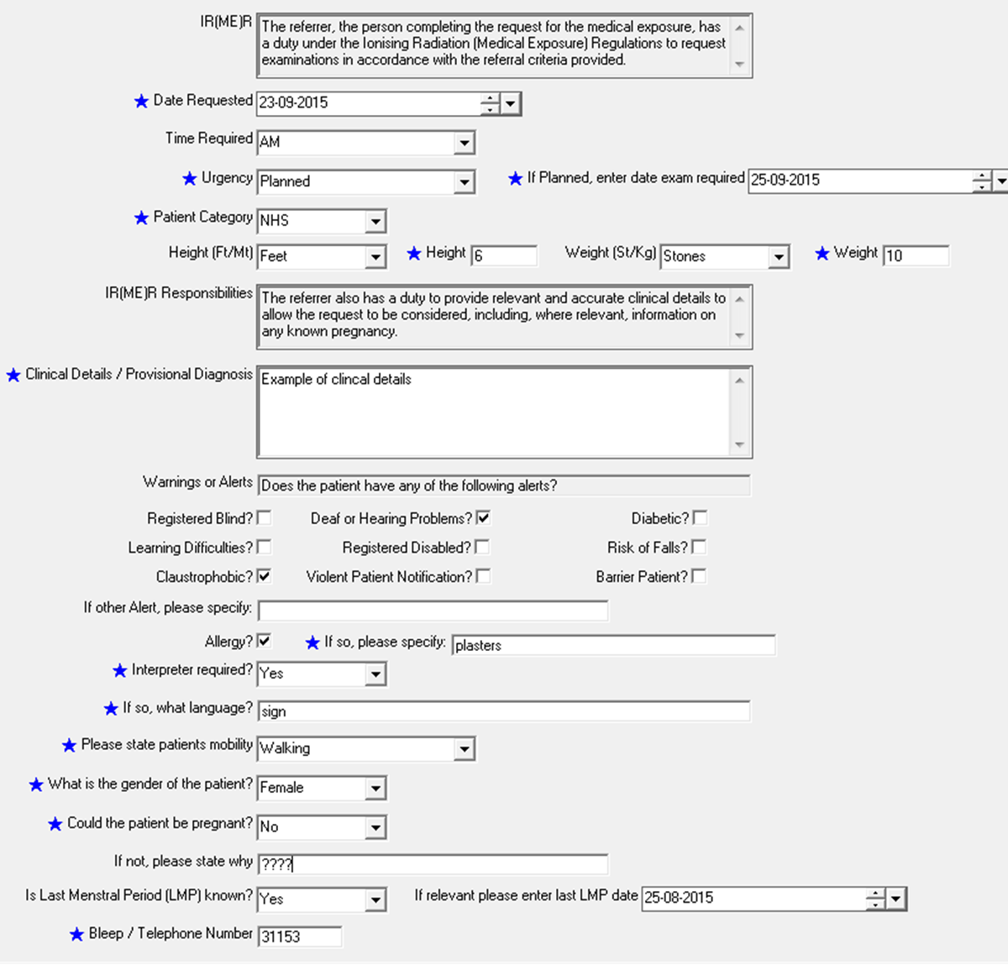
Responsibilities of the Referrer To Provide Appropriate Information
IR(ME)R Reg.5 (5)
Referrer shall
provide enough medical information (i.e. previous diagnostic information or medical records) to allow the practitioner to justify the exposure…
Notes:
Highlight relevant sections (animate)

Slide 30
Responsibilities of the Referrer Special Considerations
Special consideration is required for exposures of females of child bearing age (12 – 55).
You must provide information relevant to pregnancy status where indicated.
Notes:
Highlight relevant sections (animate)

Slide 31
Pragmatic Responsibilities of the Referrer
Referrer shall:
Pay particular attention to the accuracy of patient identification.
Make sure the requested procedure will have a bearing on patient management.
Ensure the mandatory fields which are a legal requirement denoted by are completed appropriately, this is the best form of patient radiation protection. They are auditable.
Request must be made by the Referrer and cannot be made on their behalf.
All imaging involving radiations legally needs a request from a Referrer prior to exposure.
Notes:
Add referral criteria before this one ?

Slide 32
Responsibilities of the Practitioner – Justification
The Practitioner as entitled by the employers procedures is responsible for the justification of the request i.e. whether the request is appropriate and which is the most suitable examination.
The Practitioner is usually a radiologist, or specific radiographers.
The Practitioner must consider:
objectives of intended exposure.
health benefit to individual or society.
potential detriment to individual.
exposure of females of child-bearing age.
alternative modalities & techniques to provide the required information.

Slide 33
Responsibilities of the Operator
The Operator has the practical responsibility to carry out the exposure. These responsibilities also include
Checking they have the correct patient.
Making sure the request has been justified and authorised (or authorising according to protocol).
Checking for pregnancy (where relevant).
Ensuring the exposure is optimised in using the lowest possible dose to achieve the required image quality.

Slide 34
Contingency for System Failure
Should iCM be unavailable, paper request forms will be used.
All relevant questions must be answered accurately, and Referrer clearly identified.
Failure to correctly complete the request will result in the REQUEST being RETURNED TO YOU.

Slide 35
Key Points for the Referrer : Patient Safety and Compliance with IR(ME)R
The Referrer must
Be entitled to make the request
Follow the referral criteria
Provide full and accurate details as required
Ensure they are identified and provide contact details
This is a legal duty placed on the individual enforceable under the Health and Safety at Work Act

Slide 36
Quiz
Quiz
This section of the eLearning package contains a quiz based on Radiation Protection for Referrers and the procedures to follow.
It includes questions about the subjects covered in this package and allows you to test your knowledge of the system.
After the quiz, you will be presented with your score, followed by the correct responses with explanations.

Slide 37
QUIZ Ionising Radiation
The following utilise ionising radiations (True or False)
DEXA scan
Chest x-ray
Ultrasound
MRI angiography
CT
Fluoroscopy
Bone Scan

Slide 38
QUIZ Risk
Ionising Radiation (True or False)
Can cause cancer
Has no risk at low doses
Has beneficial effects at low doses
Causes Skin damage at low doses
Causes Cardiovascular effects at doses in excess of a threshold

Slide 39
Quiz Risk :
Risk from radiation varies with (True or False)
Amount of radiation
Sex of the patient
Age of the patient
The radio-sensitivity of the organs
The types of radiation utilised

Slide 40
QUIZ Exposure
List the following in order of increasing patient dose
Bone Scan (Tc-99m)
CT Chest Abdomen Pelvis
Abdomen X-ray
Chest X-ray
Dynamic Cardiac Scan (Tc-99m)
Notes:
3
5
2
1
4

Slide 41
QUIZ Responsibilities of Referrer
Responsibilities of Referrer
True or False
Ensure the request is made in accordance with the referral criteria, having checked previous imaging and requests
Correctly identify the patient
Provide details of any known pregnancy
Take responsibility for the exposure
Provide relevant clinical details
Clearly identifies themselves and provides contact details

Slide 42
QUIZ Responsibility of Practitioner
Responsibility of Practitioner
True or False
Consider alternative modalities & techniques to provide required information
Provide relevant clinical details
Take responsibility for the exposure
Consider the request and make a judgment of whether it is justified
Consider any known pregnancy
Notes:
T
F
T
T
T

Slide 43
QUIZ Responsibilities of the Operator are :
Responsibilities of the Operator are
True or False
To carry out the exposure
To check they have the correct patient
Check the request has been justified prior to exposure
Conduct pregnancy enquires
To optimise the exposure

Slide 44
Quiz
You scored XX %
The following slides detail the correct responses and provide explanations.

Slide 45
ANSWERS Ionising Radiation
The following utilise ionising radiations (True or False)
DEXA scan : TRUE
Dexa scan utilises x-rays
Chest x-ray : TRUE
Dexa scan utilises x-rays
Ultrasound : FALSE
US utilises sound waves
MRI angiography : FALSE
MR utilises magnetic field which are non-ionising
CT : TRUE
CT utilises x-rays
Fluoroscopy : TRUE
Fluoroscopy utilises x-rays
Bone Scan : TRUE
Bone scan utilises radionuclides

Slide 46
ANSWERS Risk
Ionising Radiation (True or False)
Can cause cancer : TRUE
Has no risk at low doses : FALSE
Has beneficial effects at low doses : FALSE
Causes Skin damage at low doses : FALSE
Causes Cardiovascular effects at doses in excess of a threshold : TRUE
Ionising radiation can cause cancer with no known safe level of exposure. This is a stochastic (random) effect with the risk increasing with exposure.
Ionising radiation can also cause deterministic (tissue effects) such as skin damage and cardiovascular disease. These occur at higher doses above a threshold.
Notes:
T
F
F
F
T

Slide 47
ANSWERS Risk :
Risk from radiation varies with (True or False)
Amount of radiation : TRUE
Sex of the patient : TRUE
Age of the patient : TRUE
The radio-sensitivity of the organs : TRUE
The types of radiation utilised : TRUE
Risk from exposure varies with all these issues. We are particularly concerned about exposures of children, those of females of child bearing age and exposures with high doses
Notes:
T
T
T
T
T

Slide 48
ANSWERS Exposure
List the following in order of increasing patient dose
Radiographic Examination | Typical effective dose (mSv) | Equiv. no chest x-rays | Approx. equiv. Background radiation
Chest (PA) | 0.015 | 1 | 2.5 days
Abdomen | 0.4 | 30 | 2 months
Bone (Tc-99m) | 3 | 200 | 1.4 years
Dynamic Cardiac (Tc-99m) | 6 | 400 | 2.7 years
CT chest abdomen pelvis | 10 | 670 | 4.5 years
Examination of extremities have very low dose, radiography of the body has a low dose, CT and nuclear medicine are considered high dose examinations. Simple theatre examinations have low dose, but more complex interventional procedures can have very high doses and can result in deterministic effects.
Notes:
3
5
2
1
4

Slide 49
ANSWERS Responsibilities of Referrer
Responsibilities of Referrer (True or False)
Ensure the request is made in accordance with the referral criteria, having checked previous imaging and requests : TRUE
Correctly identify the patient : TRUE
Provide details of any known pregnancy : TRUE
Take responsibility for the exposure : FALSE
Provide relevant clinical details : TRUE
Clearly identifies themselves and provides contact details : TRUE
The Referrer (the person completing the request) must include sufficient information for the Practitioner to justify the request.
Notes:
T
T
T
F
T
T

Slide 50
ANSWERS Responsibility of Practitioner
Responsibility of Practitioner (True or False)
Consider alternative modalities & techniques to provide required information : TRUE.
Provide relevant clinical details : FALSE
Take responsibility for the exposure : TRUE
Consider the request and make a judgment of whether it is justified : TRUE
Consider any known pregnancy : TRUE
The Practitioner considers if the request is justified and takes responsibility for the exposure
Notes:
T
F
T
T
T

Slide 51
ANSWERS Responsibilities of the Operator are :
Responsibilities of the Operator are (True or False)
To carry out the exposure: TRUE.
To check they have the correct patient : TRUE
Check the request has been justified prior to exposure : TRUE
Conduct pregnancy enquires : TRUE
To optimise the exposure : TRUE
The Operator carries out practical aspects of the exposure
Notes:
T
T
T
T
T

Slide 52
For Queries & More Information
Imaging
Principal Radiographer – Diana Nicholson diana.nicholson@nhs.net
Imaging Service Line Clinical Director - Abdul Gafoor plh-tr.SLCD-Imaging@nhs.net
MRI – Christine Heales - christine.heales@nhs.net
Radiology IT - imagingit@nhs.net
Radiation Protection
Head of Clinical and Radiation Physics - Nick Rowles nrowles@nhs.net Tel. 39669
Consultant Physicist in Nuclear Medicine– Ivor Jones ivor.jones@nhs.net Tel. 52281
Clinical Specialist in Radiation Protection – Julie Stevens j.stevens4@nhs.net Tel. 31997
For iCM training or support, contact the IT Service Desk:
Online: http://online.plymouthict.nhs.uk - phone: (4) 37000 - e-mail: plymouthictservicedesk@nhs.net
Click the Home icon at the top-right of your screen to ensure your e-learning results are correctly recorded.

